Slide 1

Team Gravity
NCT Management System

Slide 2
Summary
A system for garages to use for receiving and editing bookings
The system also supports the ability to log test results

Slide 3
Summary
Android application and a desktop application
Shared database
Cloud virtual machine

Slide 4
Assumptions & Dependencies
A computer with Java installed
Access to the Internet
Android phone with access to the internet

Slide 5
Development Methods
Android application and desktop application written in Java
Database written in MySQL
Okeanos VM
GitHub

Slide 6
System Architecture
Okeanos VM constantly running
Database accessed using VM IP
Java application login – Mechanic or Admin
Android application – Mechanics only
Both access VM database

Slide 7
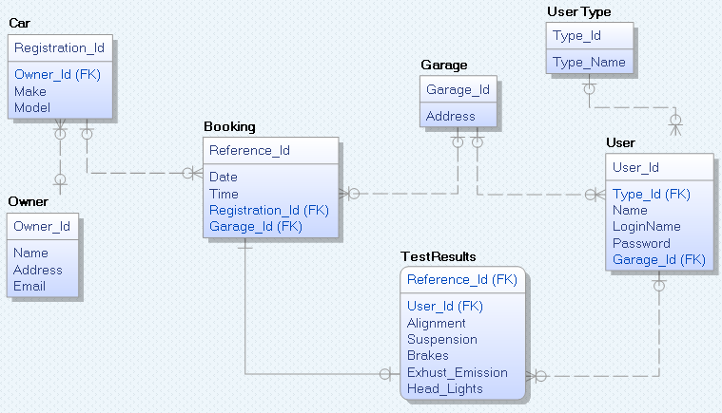
Database Design

Slide 8
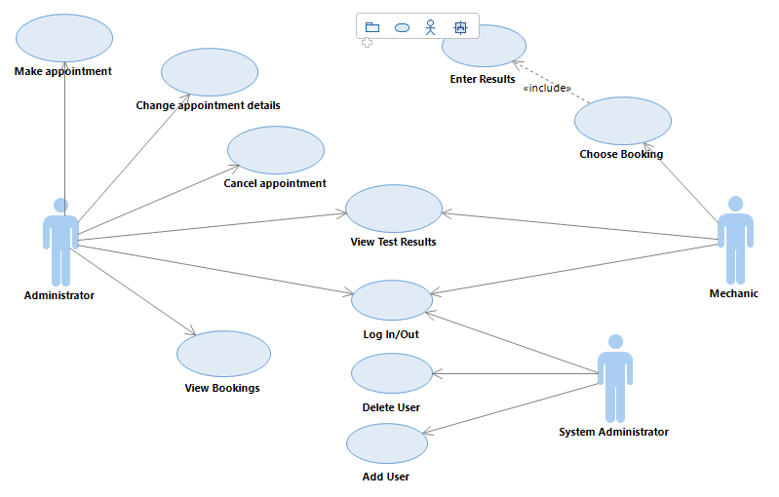
Use case diagram

Slide 9
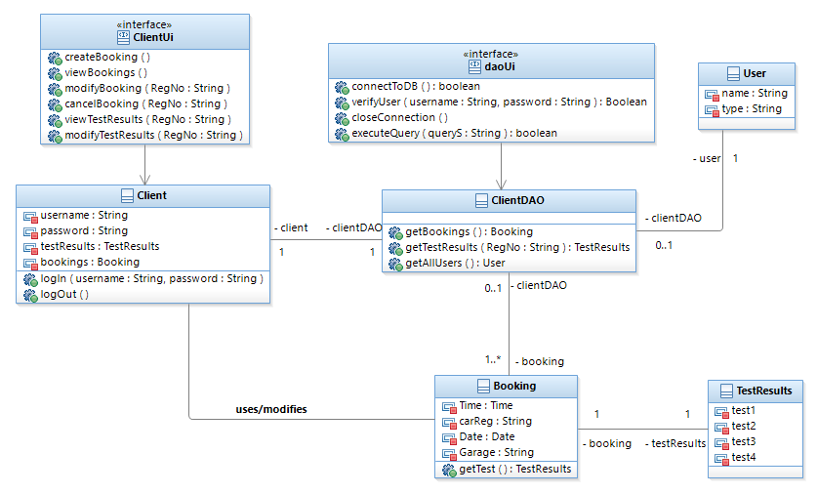
Class diagram

Slide 10
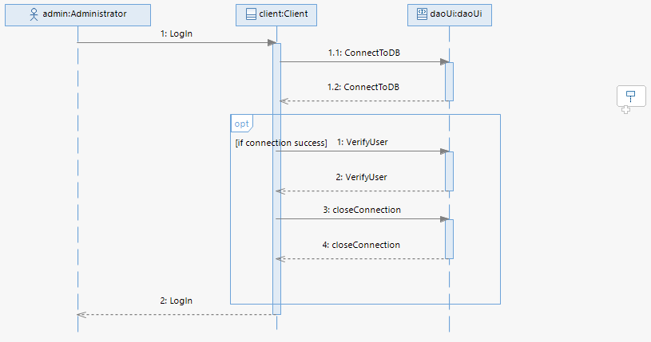
Sequence Diagram – Login

Slide 11
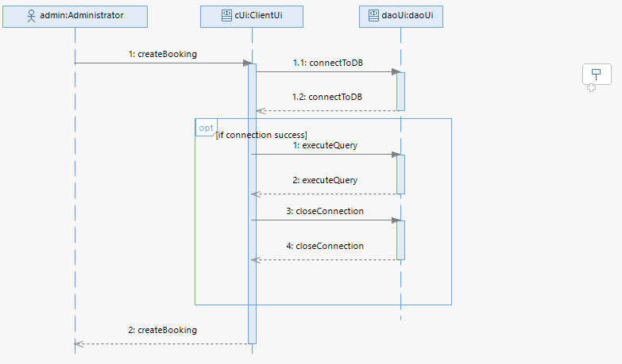
Sequence Diagram – Create/Edit Booking

Slide 12
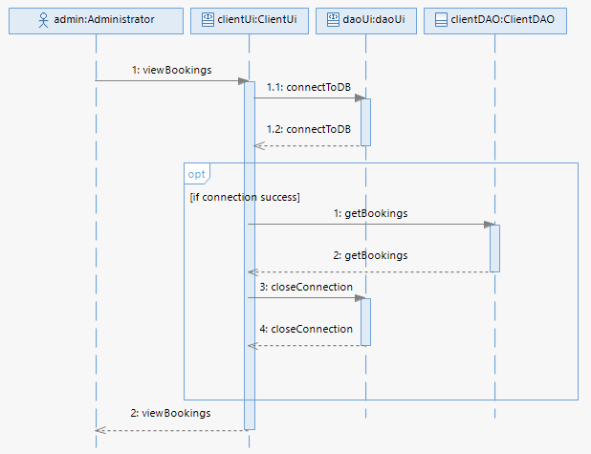
Sequence Diagram – View Bookings

Slide 13
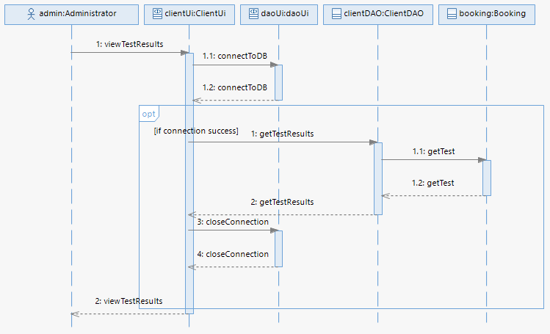
Sequence Diagram – View Test Results

Slide 14
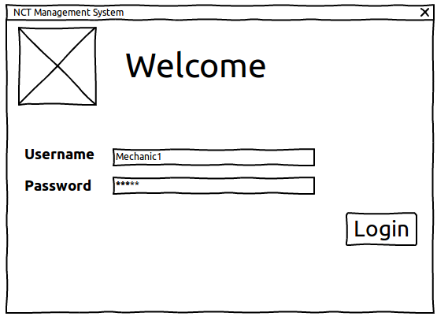
GUI Design – Desktop – Login

Slide 15
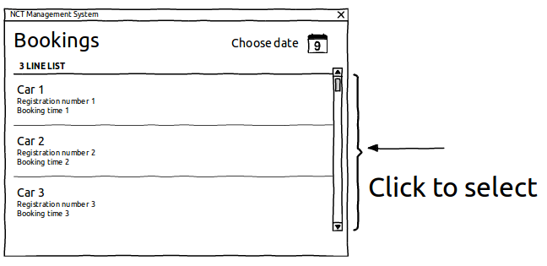
GUI Design – Desktop – Mechanic - Bookings

Slide 16
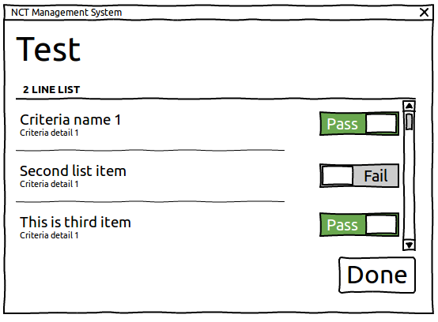
GUI Design – Desktop – Mechanic – Testing Car

Slide 17
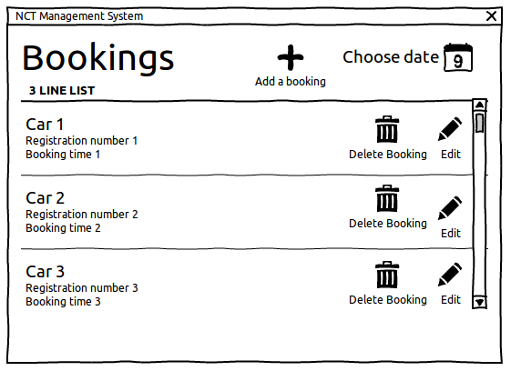
GUI Design – Desktop – Admin – Bookings

Slide 18
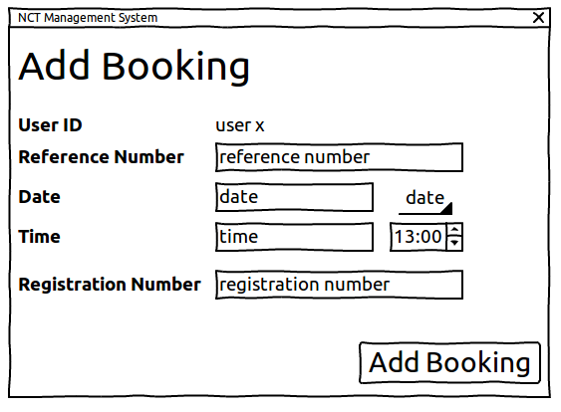
GUI Design – Desktop – Admin – Add Booking

Slide 19
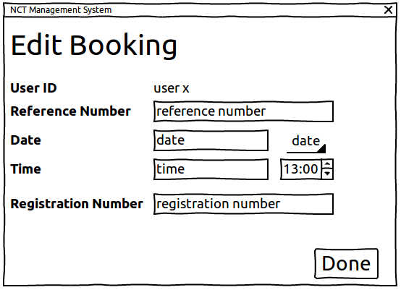
GUI Design – Desktop – Admin – Edit Booking

Slide 20
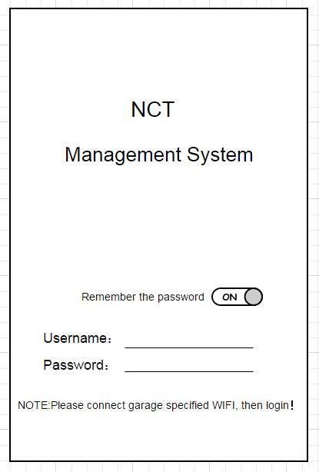
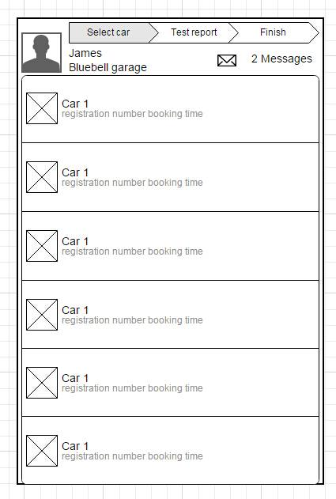
GUI Design – Android - Login and Car list

Slide 21
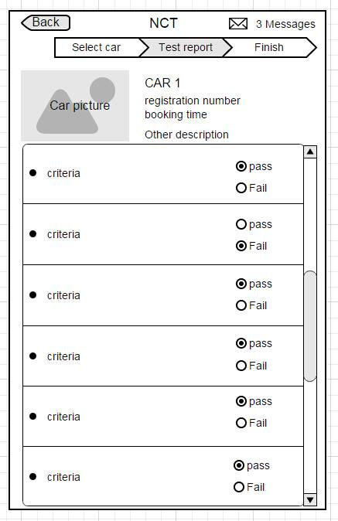
GUI Design – Android – Testing the car

Slide 22
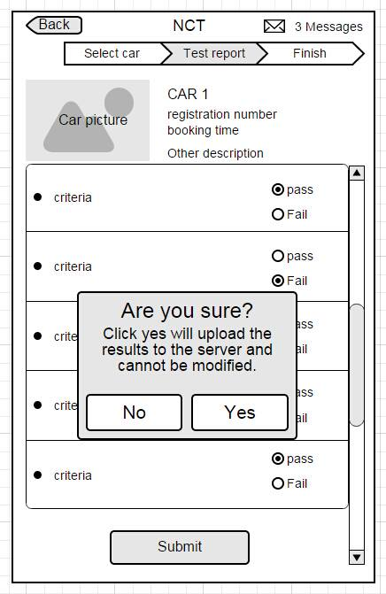
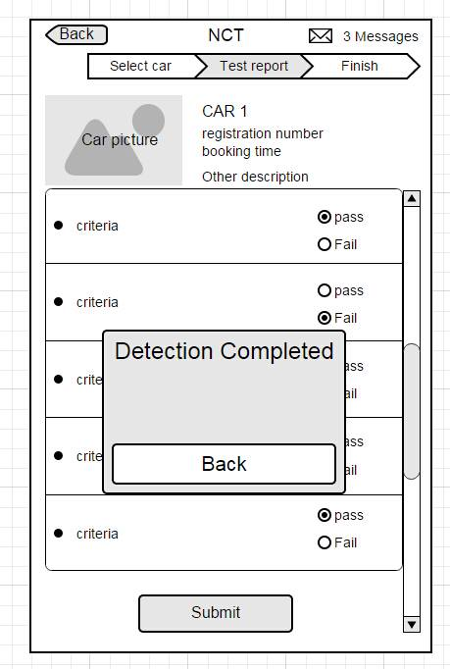
GUI Design – Android – Testing the car - Confirmation

Slide 23
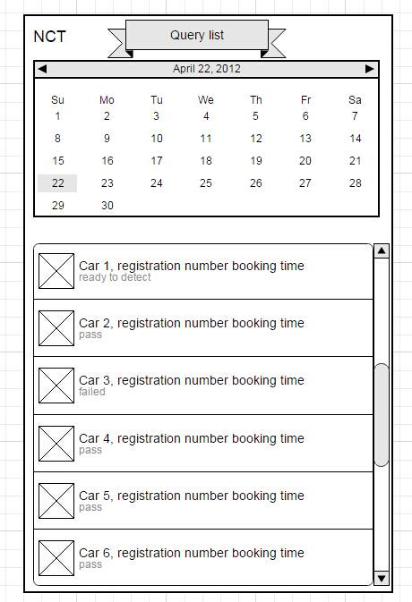
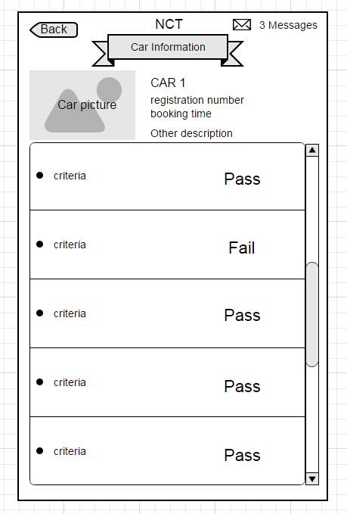
GUI Design – Android – Bookings list

Slide 24
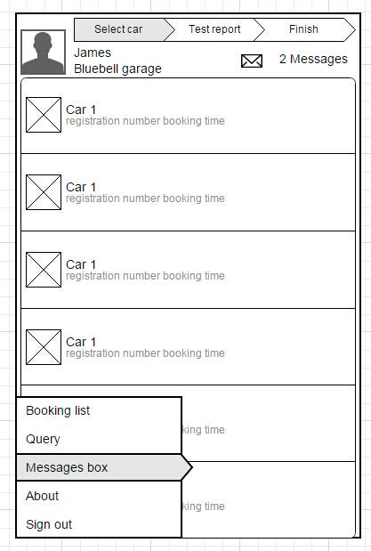
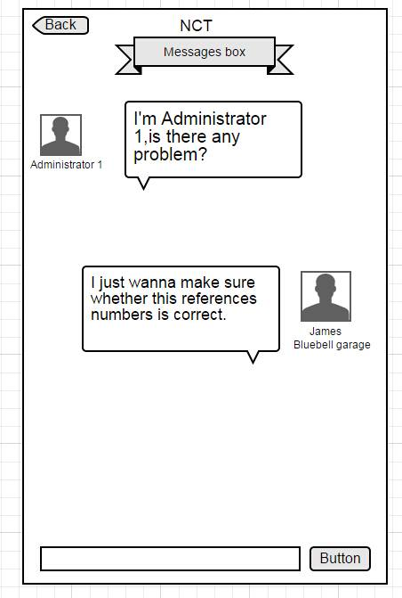
GUI Design – Android – Chat

